Slide 1




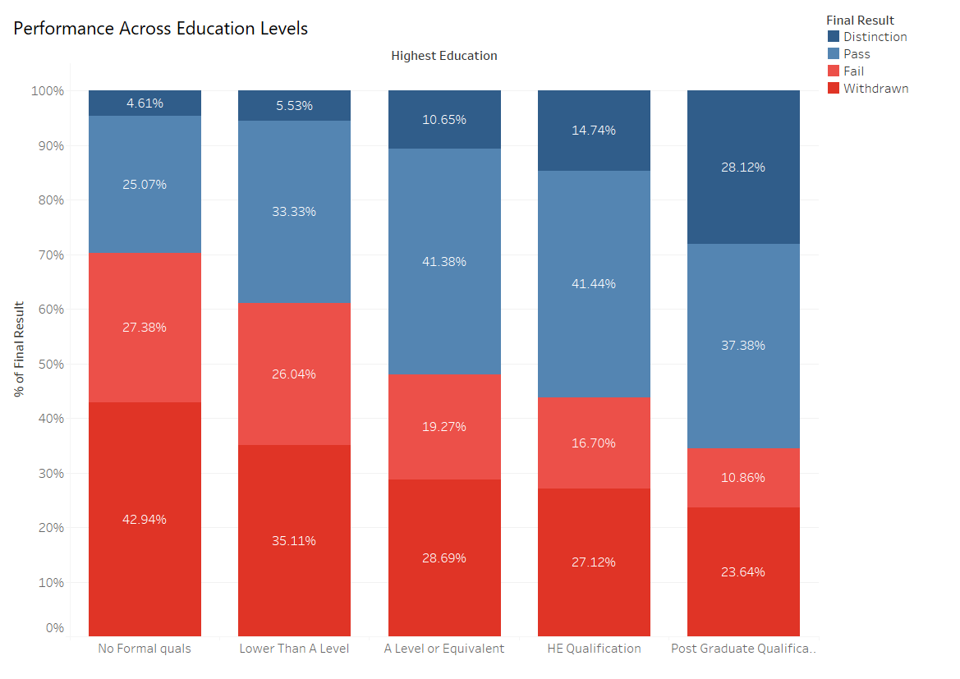


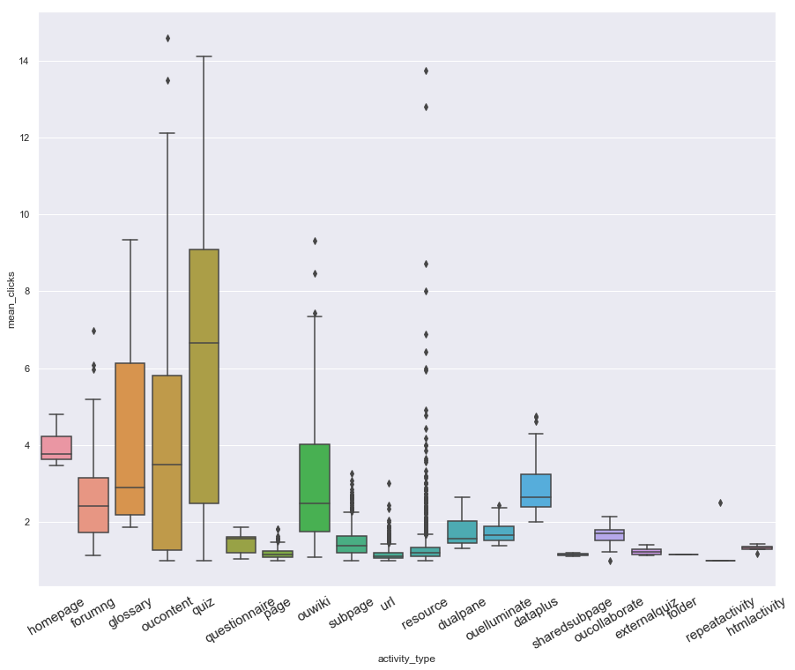
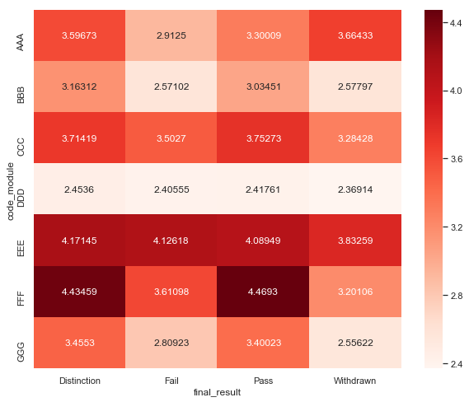
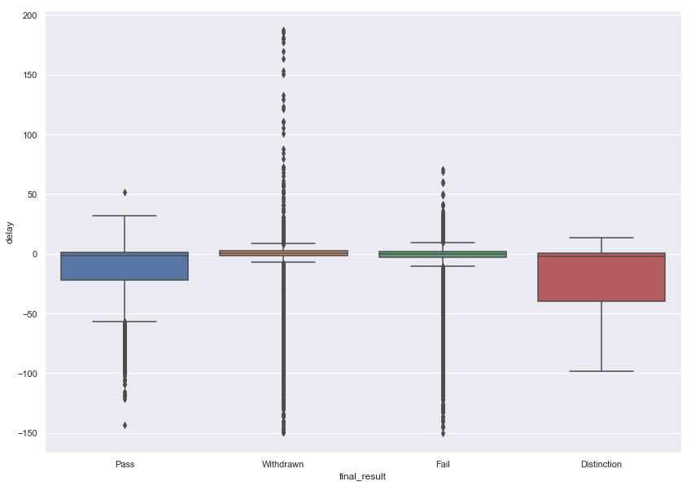
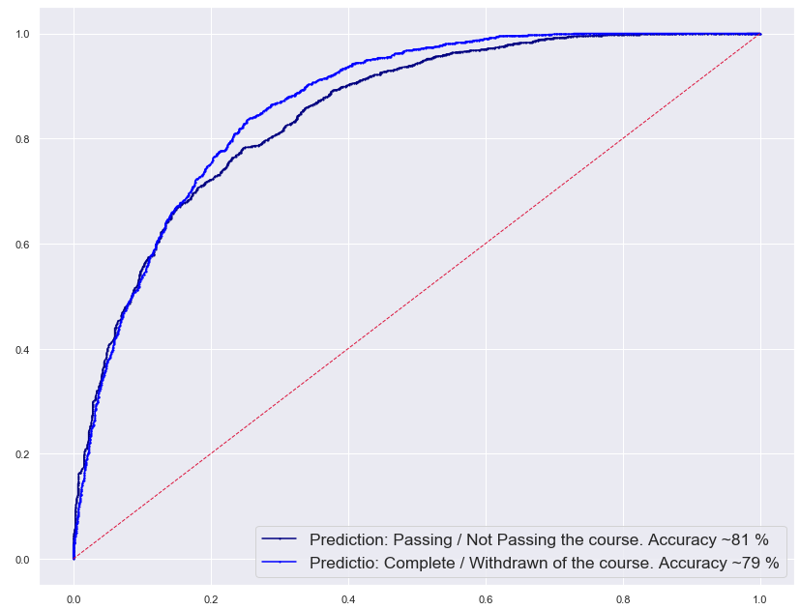





Open University: predicting students performance
Mariia Markovska, Rahul Puniani, Tedo Gogoladze
Background
Aim
Data
The Open University is a public non-profit higher education institution based in the UK. The Open University delivers knowledge exclusively via distance learning in over 100 countries worldwide.
Our aim is to identify main factors that influence students performance and efficiency of particular modules (courses), and also to build a model for the final score prediction based on available parameters.
Data consists of 7 interconnected tables which contain variables such as: student demographic information, students scores, students interaction with VLE (sum of the clicks, registration/withdrawal dates etc.).
Demographics and performance
Young (< 35)
Majority of the Open University students are young people with education of A level (43%) or lower (40%).
A major issue is prevailing of Withdraws and Fails over Passes and Distinctions
Adults (35–55)
Seniors (55 >)
Interaction with VLE*
The most engaging pages are quizzes, homepage, main content, forums and glossary. Majority of activities are not engaging (a user clicks certain page on average less than 2 times).
Average number of clicks (per course page per capita) is the highest for Distinction and Pass. Number of unengaging pages is high (a user clicks certain page on average only 3 times).
Delays in submission of assignments are more significant in case of Withdraws and Fails which lets us assume that there is a correlation between the time of assignments submission and the final score.
We are predicting:
Passing vs Not Passing binary class label
Completing vs Withdrawing of the course binary class label
For both of the classification prediction we used Random Forest model.
Variables included: course module and semester, demographics of a student, number of previous attempts of the course, studied credits, learning environment interaction score, average submission delay of a student, registration date of a student on the course.
Conclusions and recommendations
Main issues of the Open University are: prevalence of negative final results over positive, poor interaction with VLE, delays in submissions.
Our recommendation is to use prediction model to identify those students who are likely to fail or withdraw and provide them with customized and more supportive interface based on their learning needs.
81%
for ‘Passing’ label prediction
79%
for ‘Complete’ label prediction
* VLE – virtual learning environment
project repository:

